Slide 1

Recovery and analysis of metagenome-assembled genomes
Andrea Watson
Chang lab meeting
11.20.17

Slide 2
What is a metagenome?

Slide 3
What is a metagenome?
Sequenced environmental DNA for the study of the collective microbial genomes present in a sample

Slide 4
What is a metagenome?
Sequenced environmental DNA for the study of the collective microbial genomes present in a sample
microbial community

Slide 5
What is a metagenome?
Sequenced environmental DNA for the study of the collective microbial genomes present in a sample
microbial community
isolated DNA

Slide 6
What is a metagenome?
Sequenced environmental DNA for the study of the collective microbial genomes present in a sample
…
>read_1
TCTCAGCGCGTAGTGCCAGCCGCCGCGGTAATACAGAGGGTGCAAGCGTTAATCGGAATT ACTGGGCGTAAAGCGTGTGTAGGTGGTCTGTTAAGTCAGATGTGAAATCCCTGGGCTCAA CCTGGGAACTGCATTTGATACTGTCATACTAGAGTGTGGTAGAGGGTAGTGGAATTCCGC >read_2
TCTCAGCGCGTAGTGTCAGCCGCCGCGGTAATACGTAGGGTGCGAGCGTTAATCGGAATT ACTGGGCGTAAAGCGTGCGCAGGCGGATTGTTAAGCAAGACGTGAAATCCCCGGGCTTAA CCTGGGAATGGCGTTTTGAACTGGCAGTCTAGAGTGCGTCAGAGGGGGGTGGAATTCCAC >read_3
TTGTAGCAGTGAAATGCGTAGAGATGTGGAGGAACACCGATGGCGAAGGCAGCCCCCTGG GATGACACTGACGCTCATGTACGAAAGCGTGGGTAGCAAACAGGATTAGATACCCTGGTA GTCCACGCCCTAAACGATGTCAACTGGTTGTTGGGGGAGTGAAATCCCTTAGTAACGAAG >read_4
CTAACGCGTGAAGTTGACCGCCTGGGGAGTACGGTCGCAAGATTAAAACTCAAATGAATT GACGGGGATGTAGCGGTGAAATGCGTAGAGATGCGGAGGAACACCAGTGGCGAAGGCG CCAAACACTGACACTTAGGCACGAAAGCGTGGGTAGCAAACAGGATTAGATACCCTGTAG
>read_5
TCTCAGCGCGTAGTGCCAGCCGCCGCGGTAATACAGAGGGTGCAAGCGTTAATCGGAATT ACTGGGCGTAAAGCGTGTGTAGGTGGTCTGTTAAGTCAGATGTGAAATCCCTGGGCTCAA CCTGGGAACTGCATTTGATACTGTCATACTAGAGTGTGGTAGAGGGTAGTGGAATTCCGC
…
microbial community
isolated DNA
sequencing reads
(metagenome)

Slide 7
What is a metagenome-assembled genome (MAG)?
MAGs

Slide 8
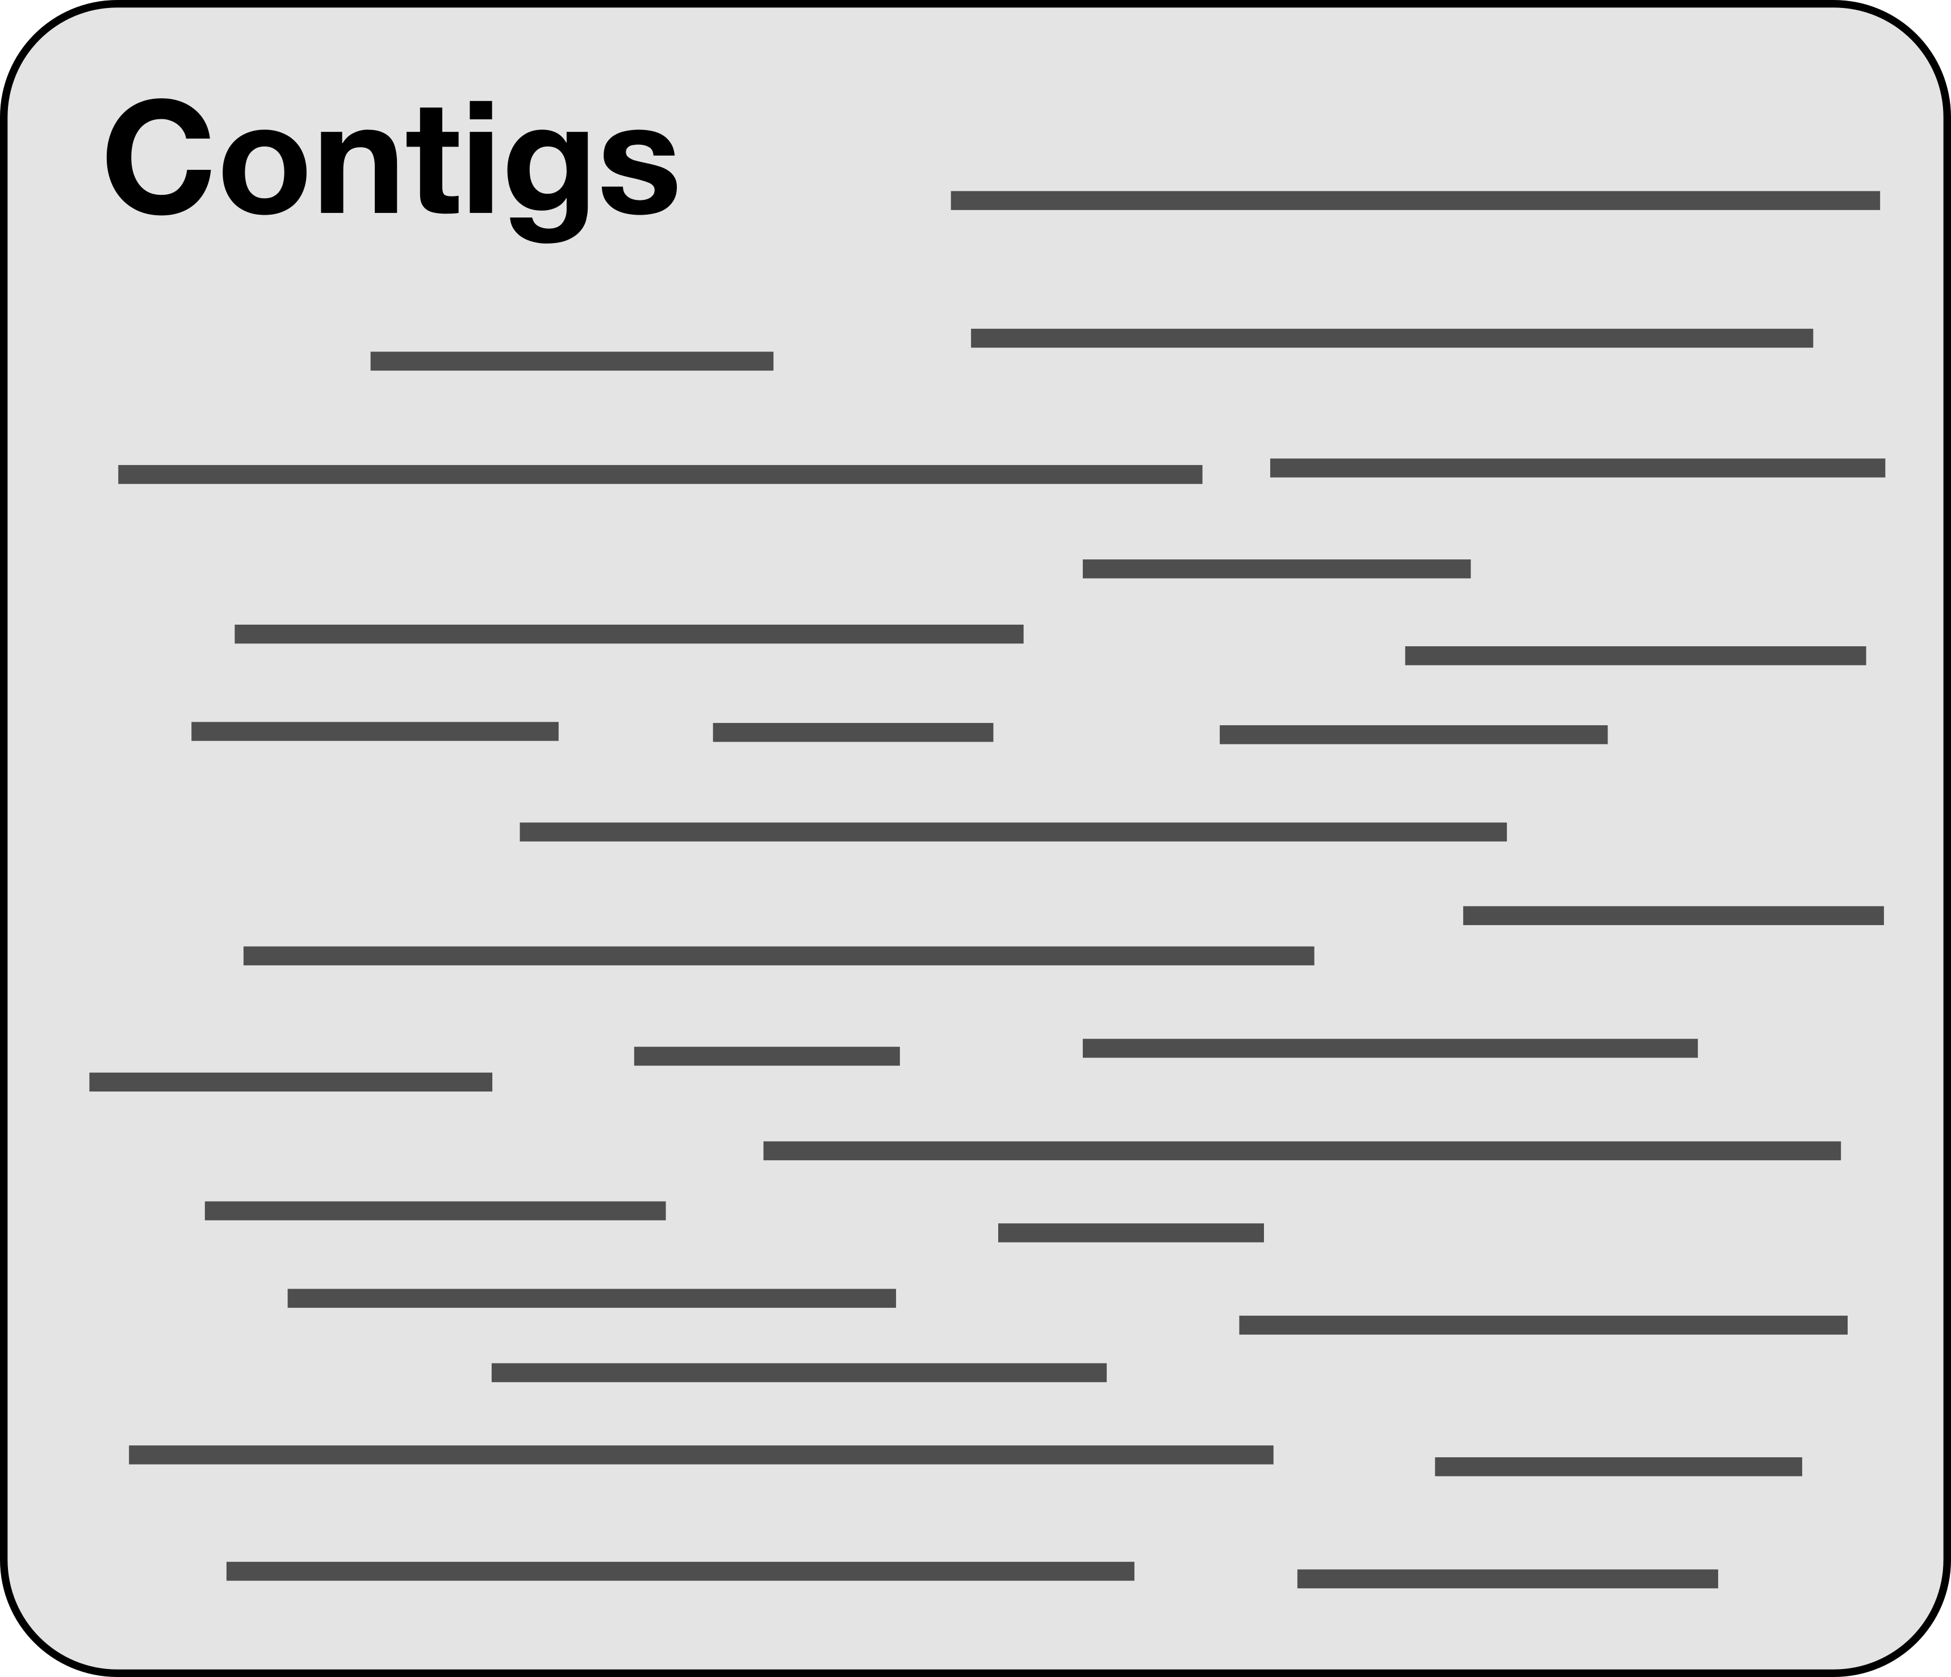
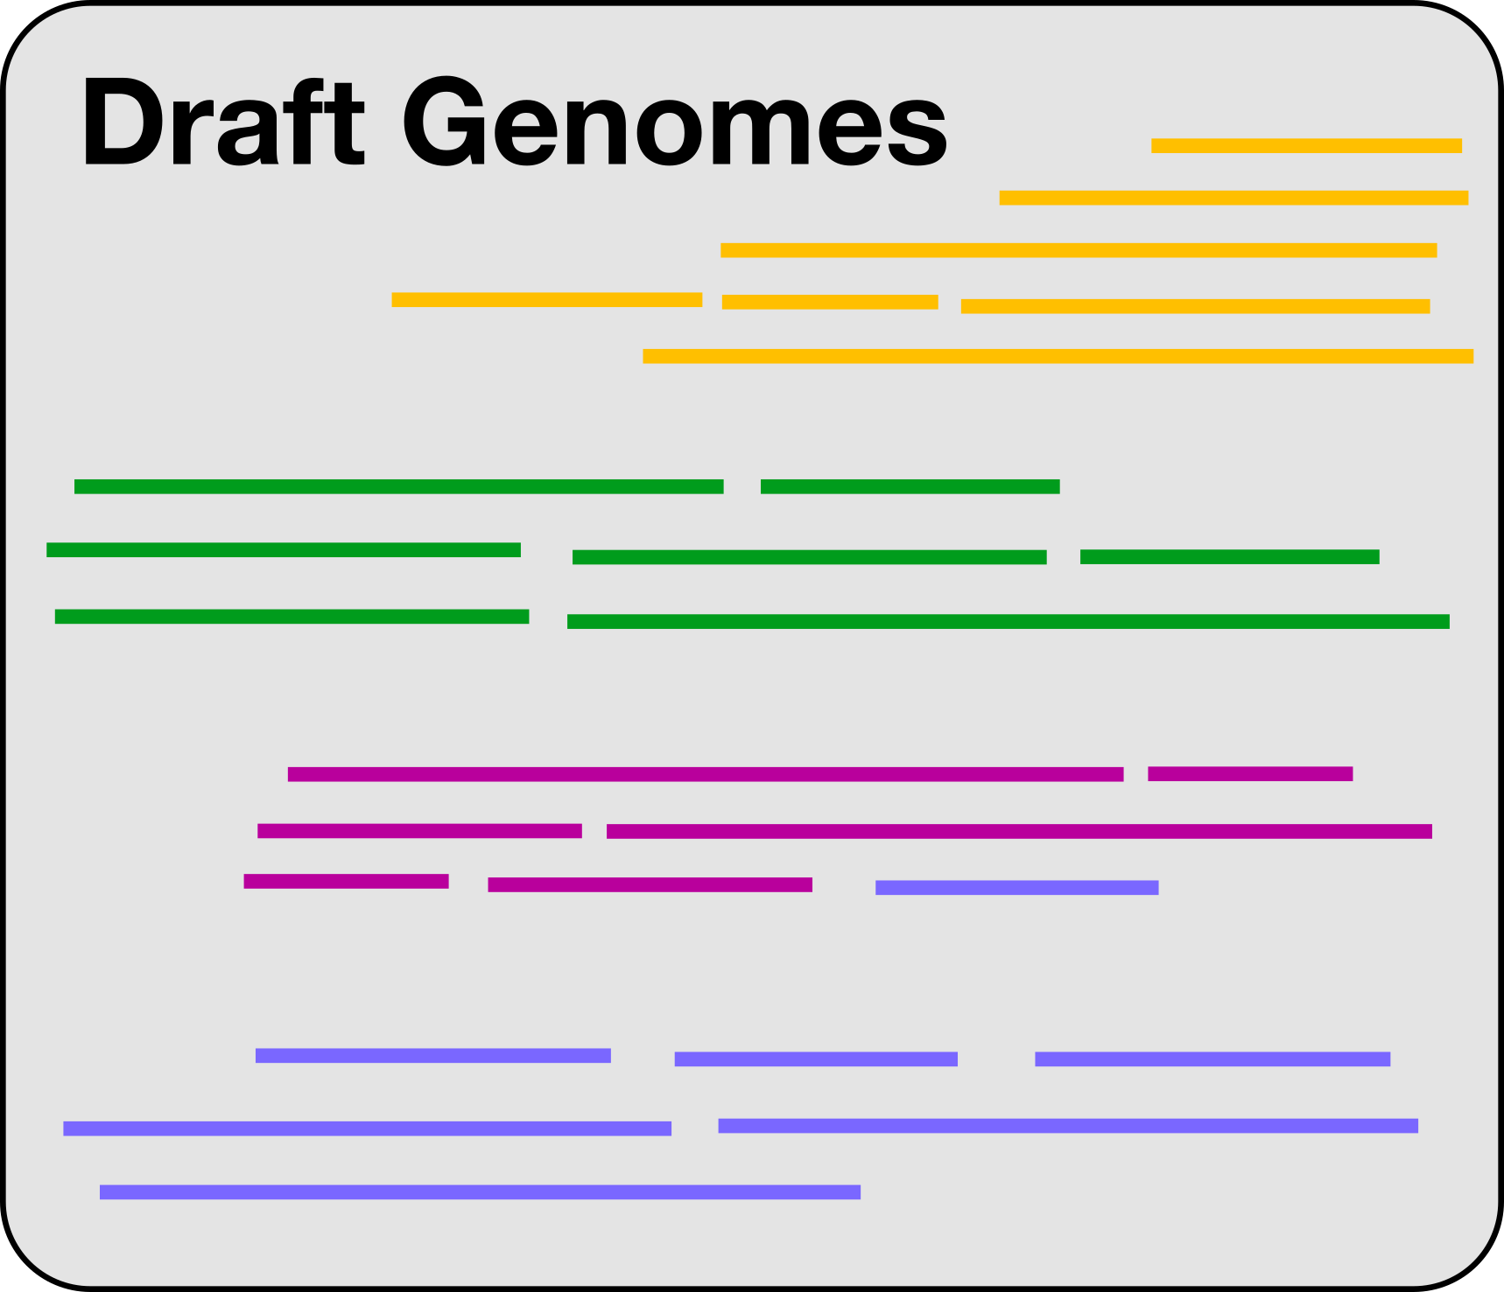
How do we bin contigs into MAGs?
?
MAGs

Slide 9
How do we bin contigs into MAGs?
sequence composition
& differential coverage
MAGs

Slide 10
Binning contigs by sequence composition using tetranucleotide frequency
Frequency that every possible 4-base combination occurs in a given nucleotide sequence
Preserved across different regions of same genome
AAAA AAAT AAAG AAAC AATA AATT AATG AATC AAGA AAGT AAGG AAGC AACA AACT AACG AACC ATAA ATAT ATAG ATAC ATTA ATTT ATTG ATTC ATGA ATGT ATGG ATGC ATCA ATCT ATCG ATCC AGAA AGAT AGAG AGAC AGTA AGTT AGTG AGTC AGGA AGGT AGGG AGGC AGCA AGCT AGCG AGCC ACAA ACAT ACAG ACAC ACTA ACTT ACTG ACTC ACGA ACGT ACGG ACGC ACCA ACCT ACCG ACCC TAAA TAAT TAAG TAAC TATA TATT TATG TATC TAGA TAGT TAGG TAGC TACA TACT TACG TACC TTAA TTAT TTAG TTAC TTTA TTTT TTTG TTTC TTGA TTGT TTGG TTGC TTCA TTCT TTCG TTCC TGAA TGAT TGAG TGAC TGTA TGTT TGTG TGTC TGGA TGGT TGGG TGGC TGCA TGCT TGCG TGCC TCAA TCAT TCAG TCAC TCTA TCTT TCTG TCTC TCGA TCGT TCGG TCGC TCCA TCCT TCCG TCCC GAAA GAAT GAAG GAAC GATA GATT GATG GATC GAGA GAGT GAGG GAGC GACA GACT GACG GACC GTAA GTAT GTAG GTAC GTTA GTTT GTTG GTTC GTGA GTGT GTGG GTGC GTCA GTCT GTCG GTCC GGAA GGAT GGAG GGAC GGTA GGTT GGTG GGTC GGGA GGGT GGGG GGGC GGCA GGCT GGCG GGCC GCAA GCAT GCAG GCAC GCTA GCTT GCTG GCTC GCGA GCGT GCGG GCGC GCCA GCCT GCCG GCCC CAAA CAAT CAAG CAAC CATA CATT CATG CATC CAGA CAGT CAGG CAGC CACA CACT CACG CACC CTAA CTAT CTAG CTAC CTTA CTTT CTTG CTTC CTGA CTGT CTGG CTGC CTCA CTCT CTCG CTCC CGAA CGAT CGAG CGAC CGTA CGTT CGTG CGTC CGGA CGGT CGGG CGGC CGCA CGCT CGCG CGCC CCAA CCAT CCAG CCAC CCTA CCTT CCTG CCTC CCGA CCGT CCGG CCGC CCCA CCCT CCCG CCCC

Slide 11

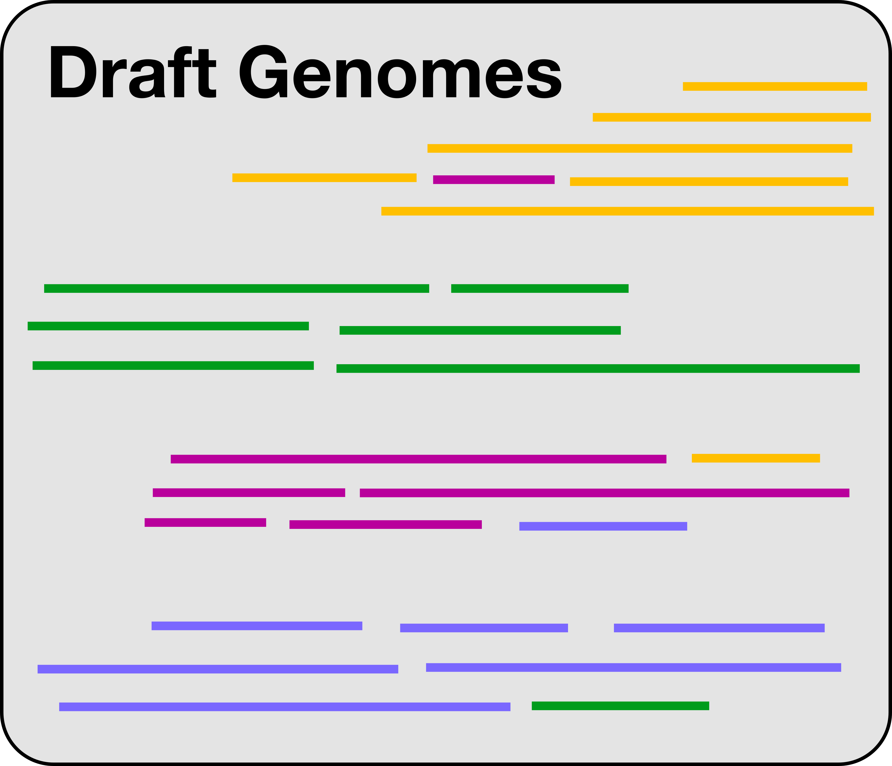
Binning by sequence composition only

Slide 12
Binning contigs by differential coverage
Coverage is the average number of short reads mapping to each nucleotide position throughout a contig
Contigs with similar coverage are more likely to belong to the same genome

Slide 13
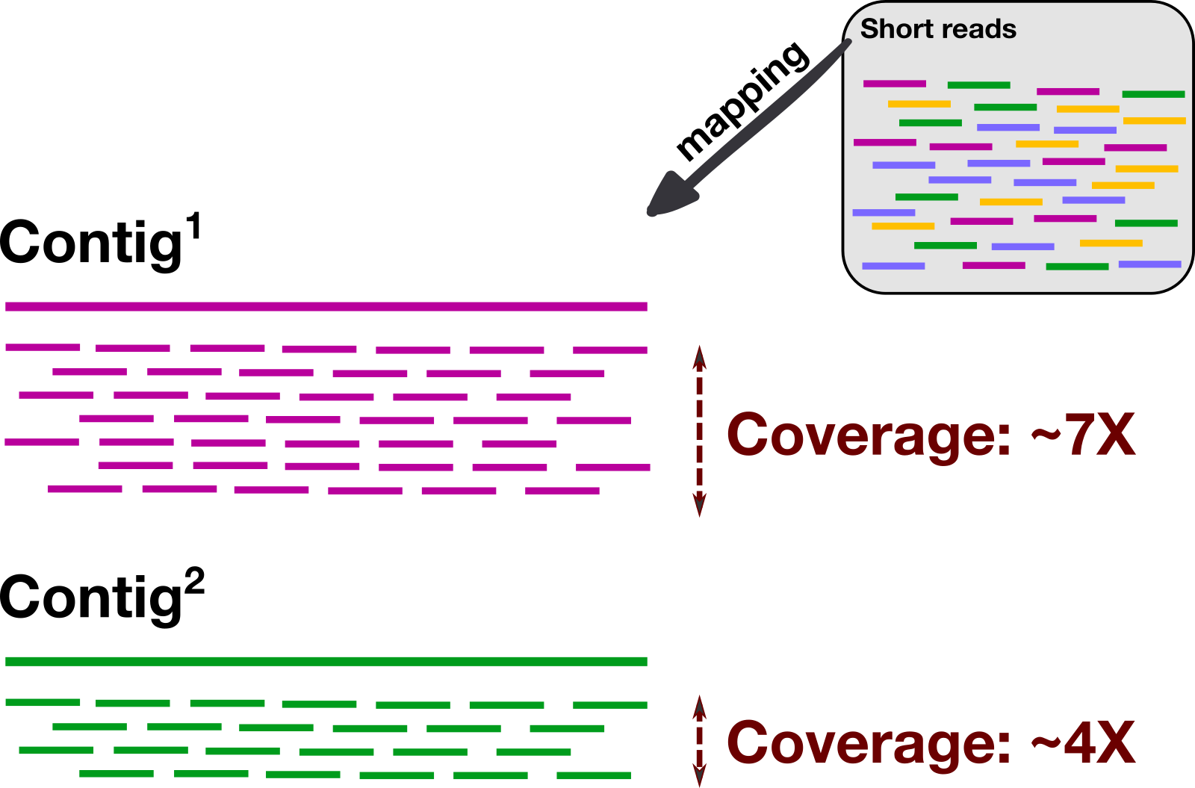
Binning contigs by differential coverage

Slide 14
Binning by sequence composition
and by differential coverage

Slide 15
Manual Binning in Anvi’o
Notes:
CONTIG STATS – single copy core genes and predicted number of genomes --- # of contigs (over 200,000)
ANVI SUMMARIZE of initial 25 bins (made with CONCOCT) --- completion and redundancy
Refining bin_9:
Each leaf is a contig (sometimes split into multiple ”splits”, see parent ring)
Organized by similarity taking into account sequence composition and diffferential coverage
Predicted taxonomy
Mapping of short reads from each sample used to construct these contigs, back onto the contigs (allows us to see differential coverage visually)

Slide 16
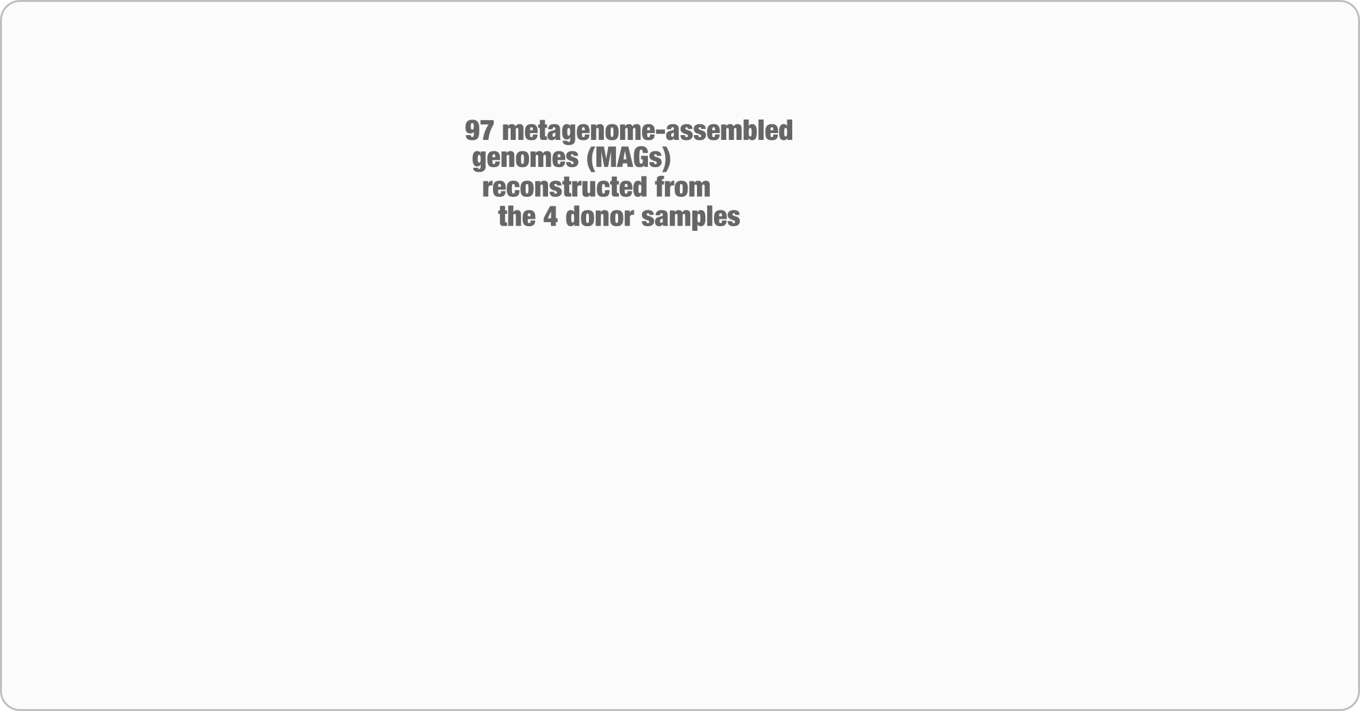
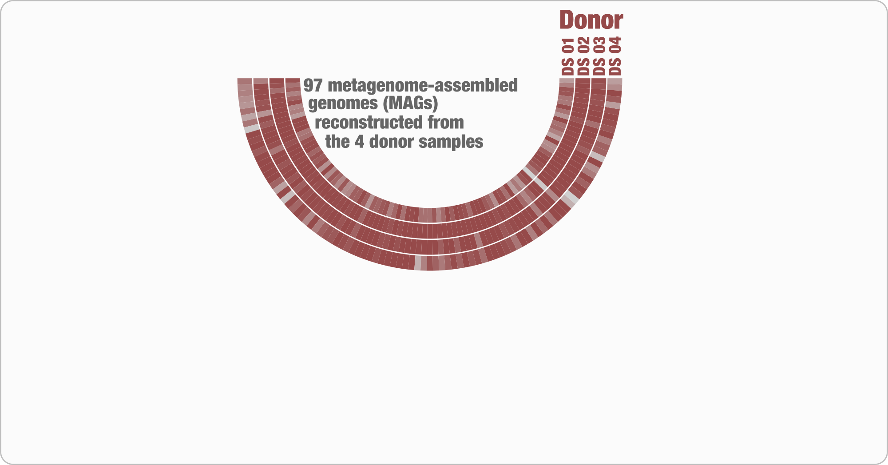
Lee, Sonny TM, et al. Microbiome (2017)

Slide 17
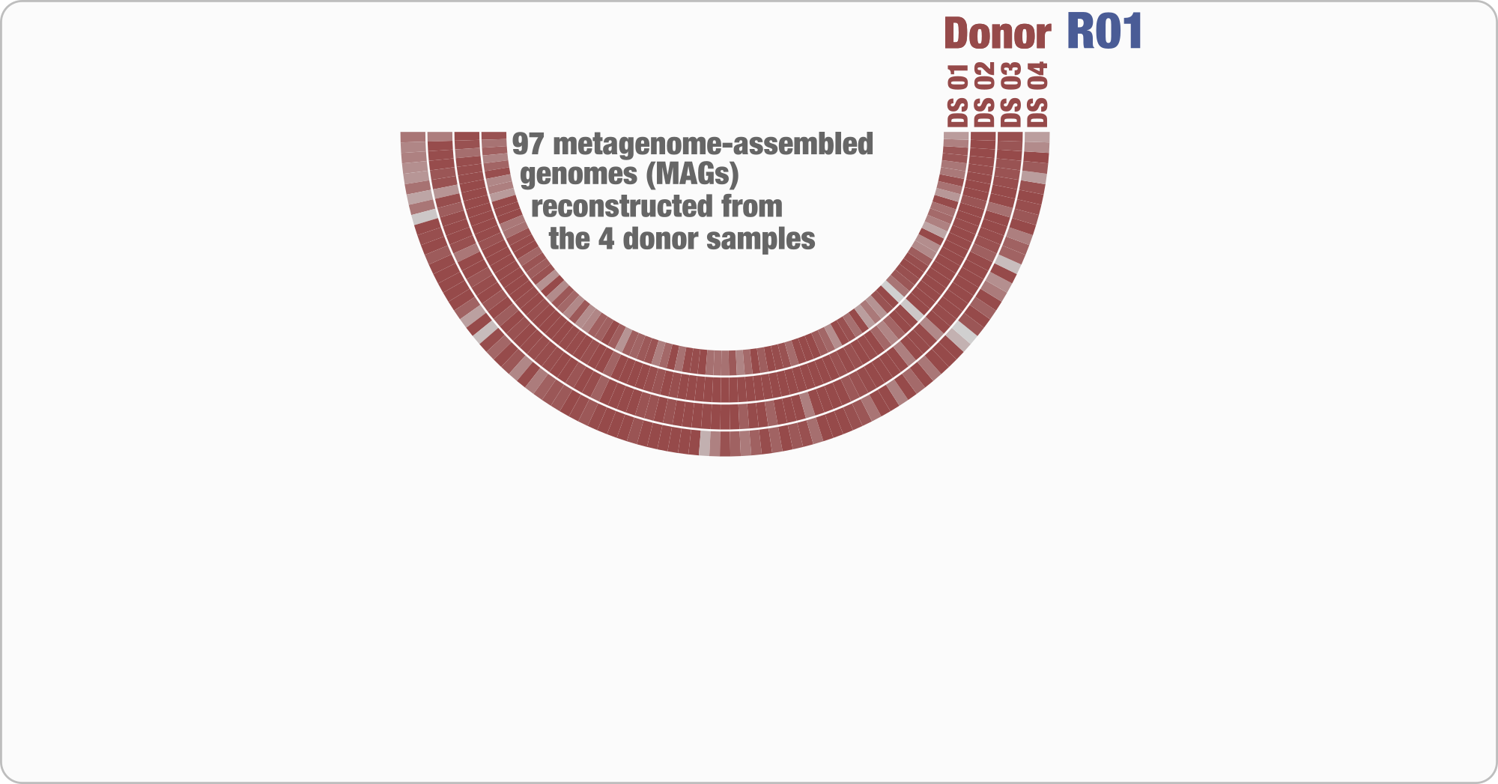
Lee, Sonny TM, et al. Microbiome (2017)

Slide 18
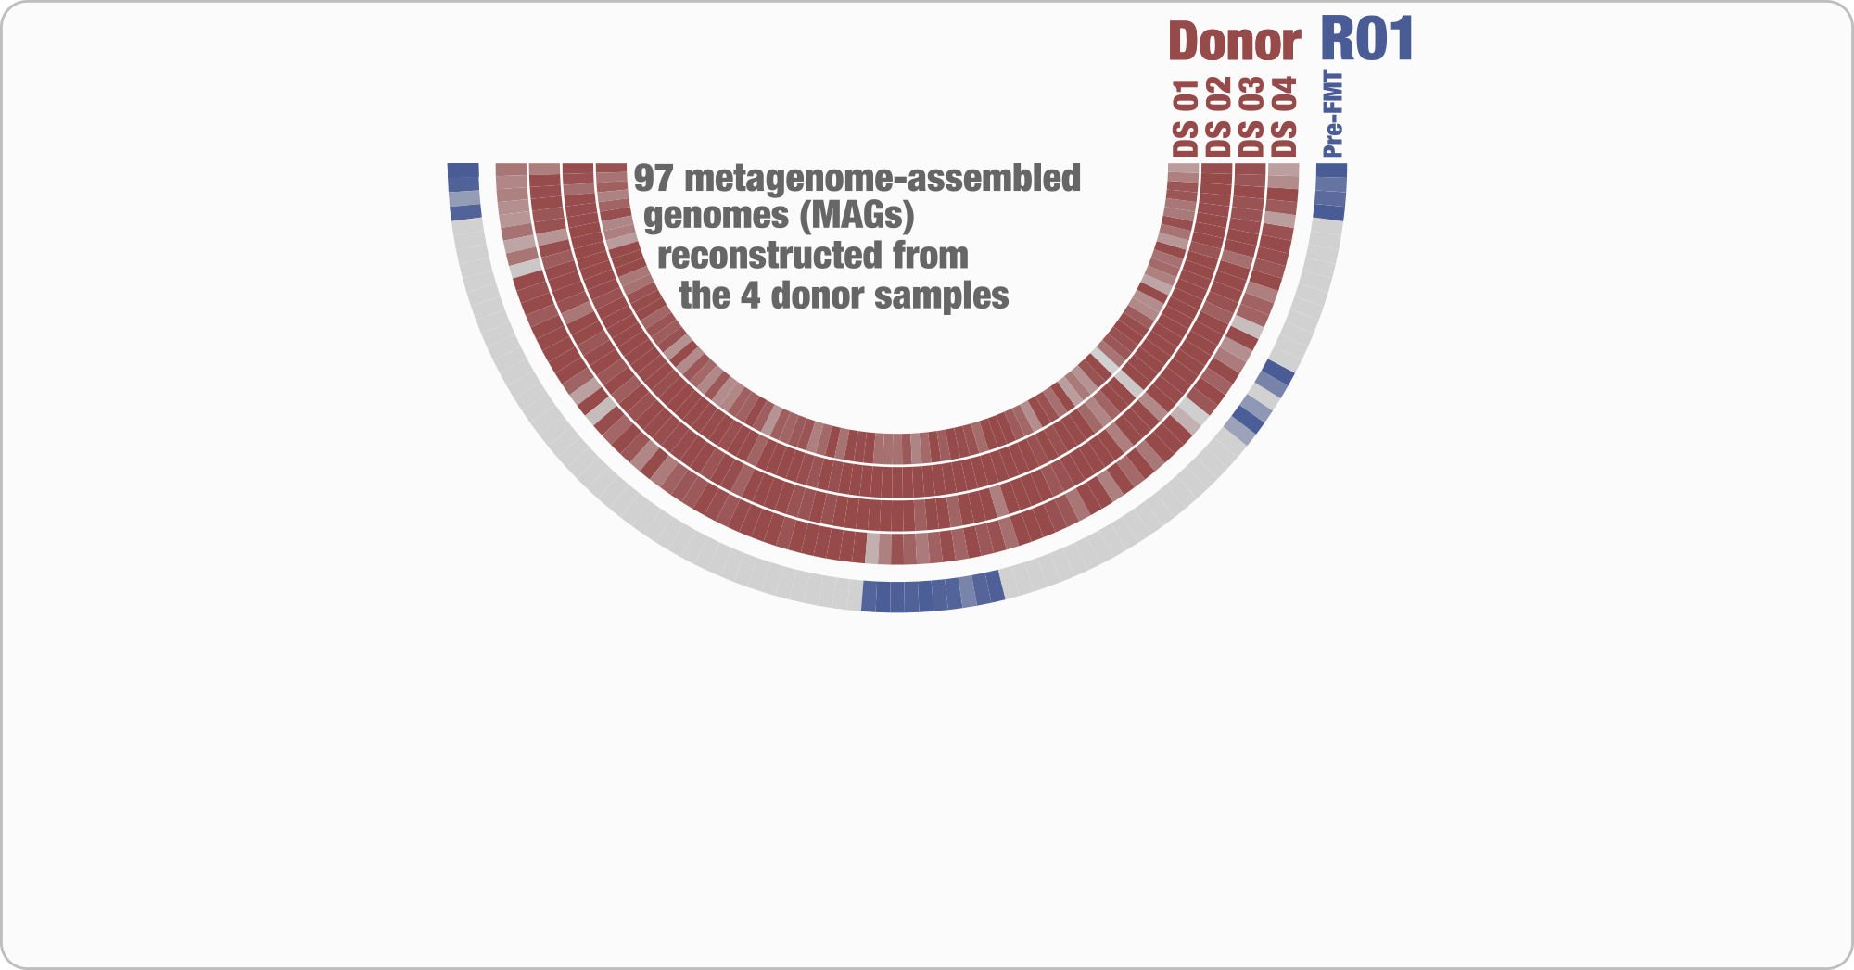
Lee, Sonny TM, et al. Microbiome (2017)

Slide 19
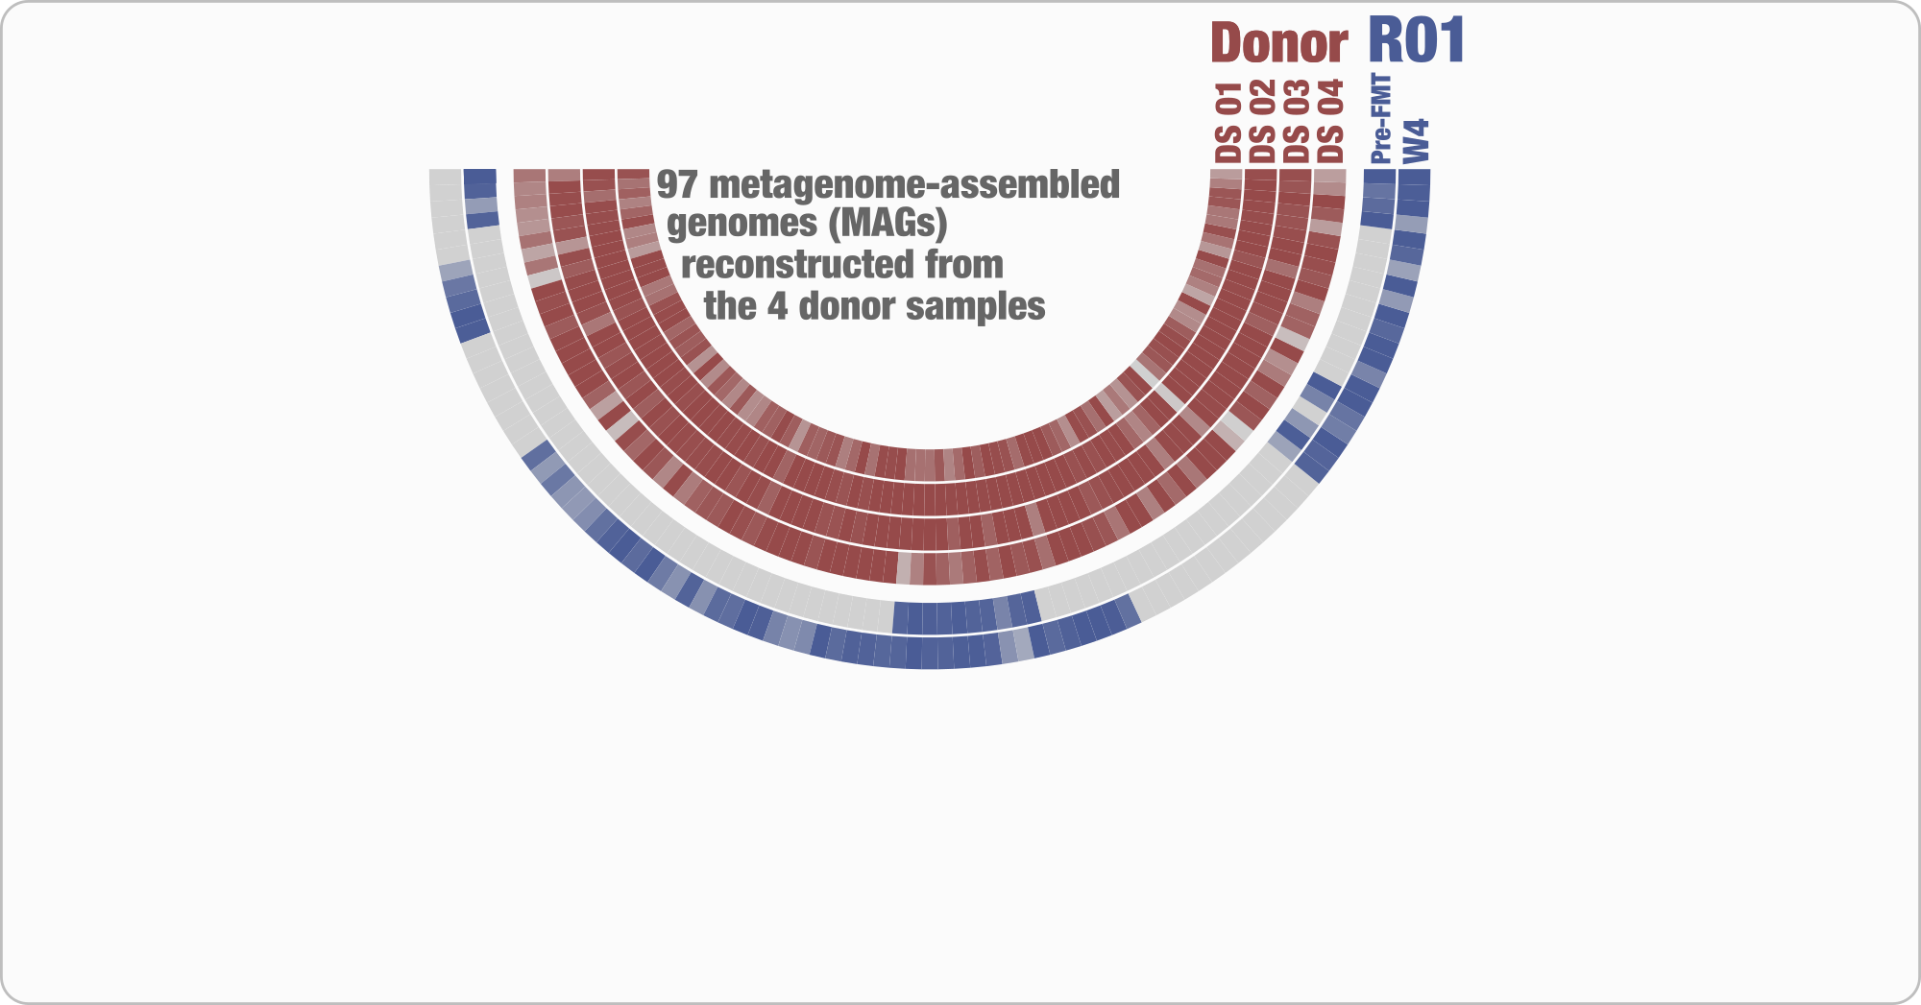
Lee, Sonny TM, et al. Microbiome (2017)

Slide 20
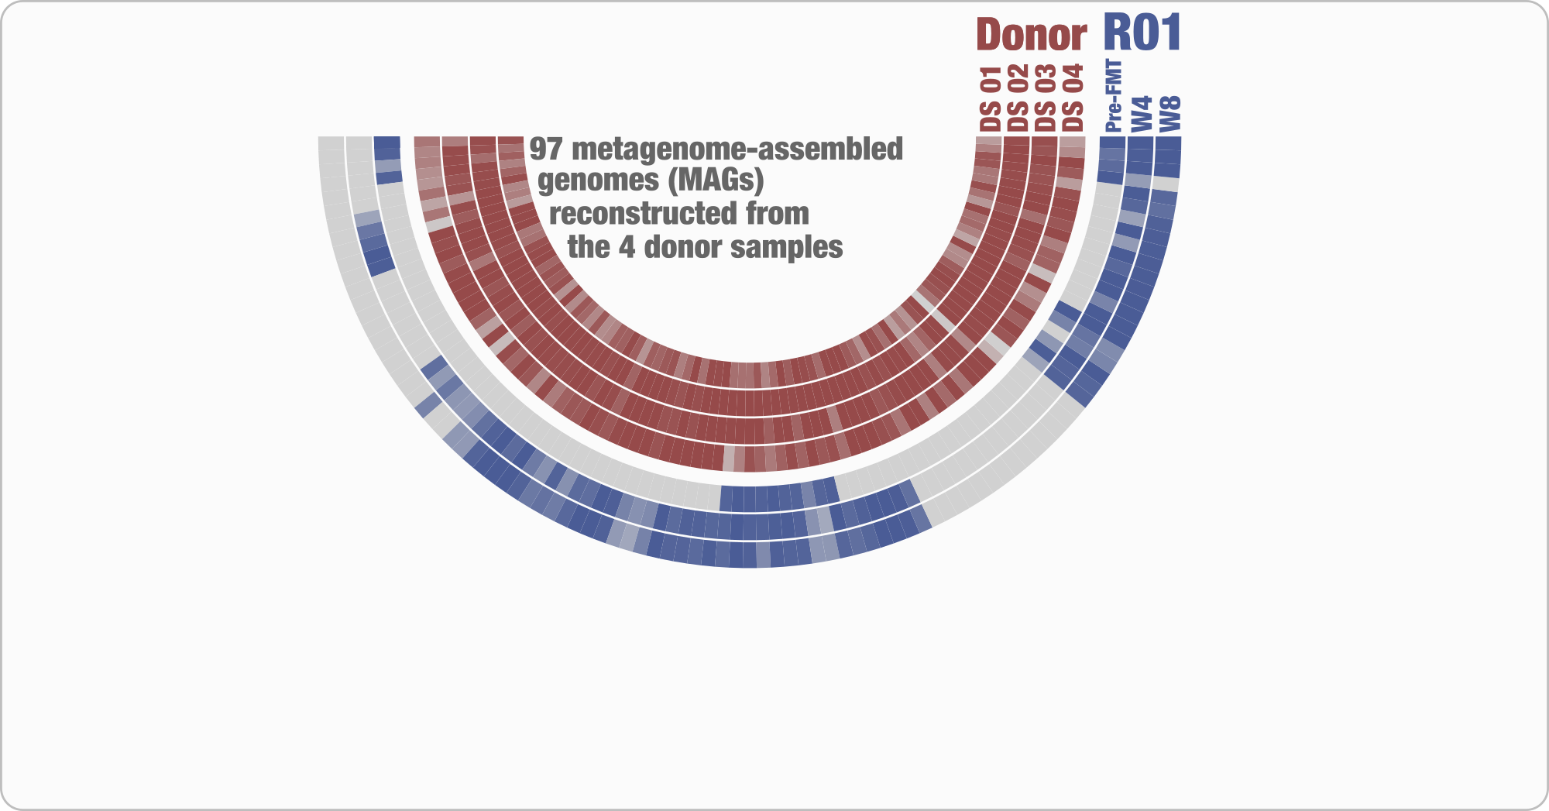
Lee, Sonny TM, et al. Microbiome (2017)

Slide 21
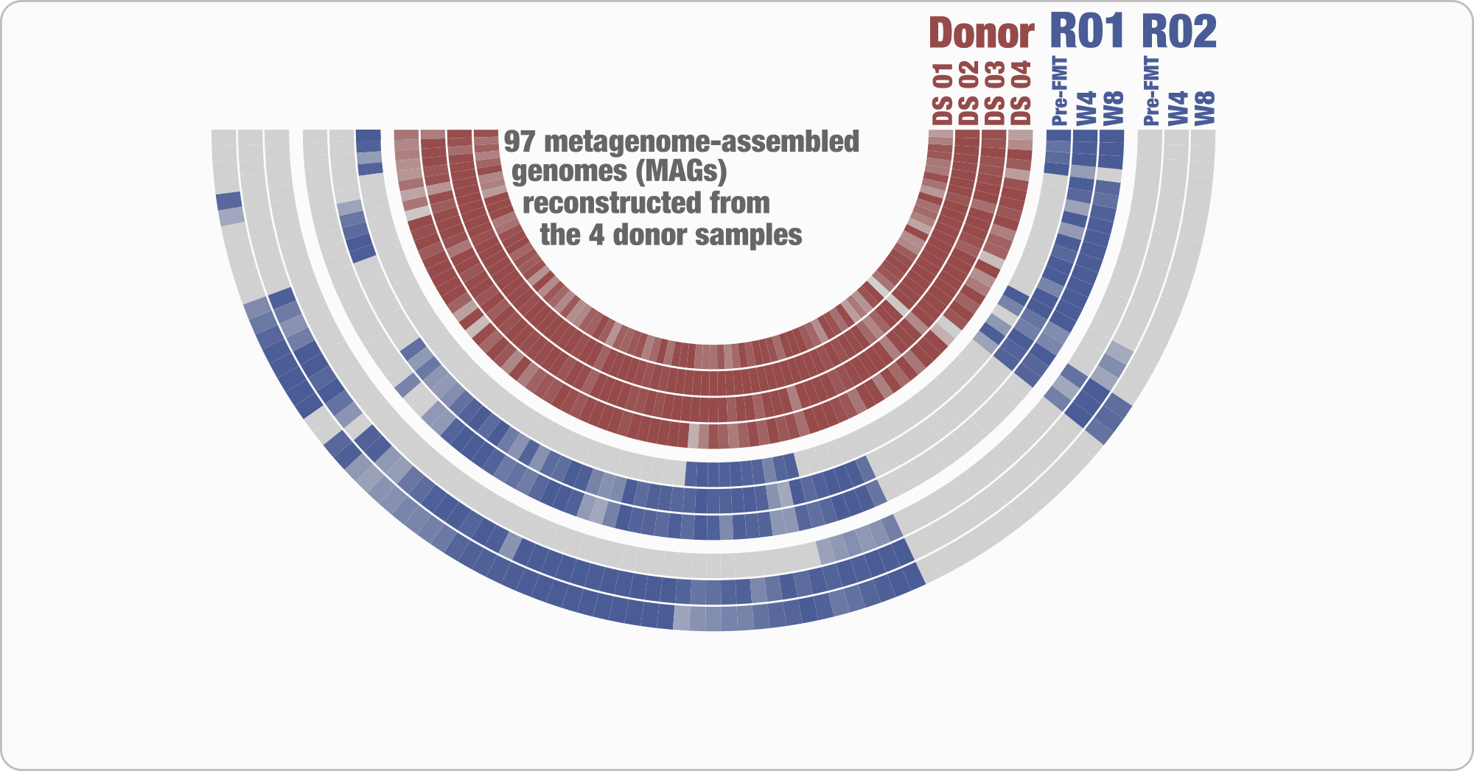
Lee, Sonny TM, et al. Microbiome (2017)

Slide 22
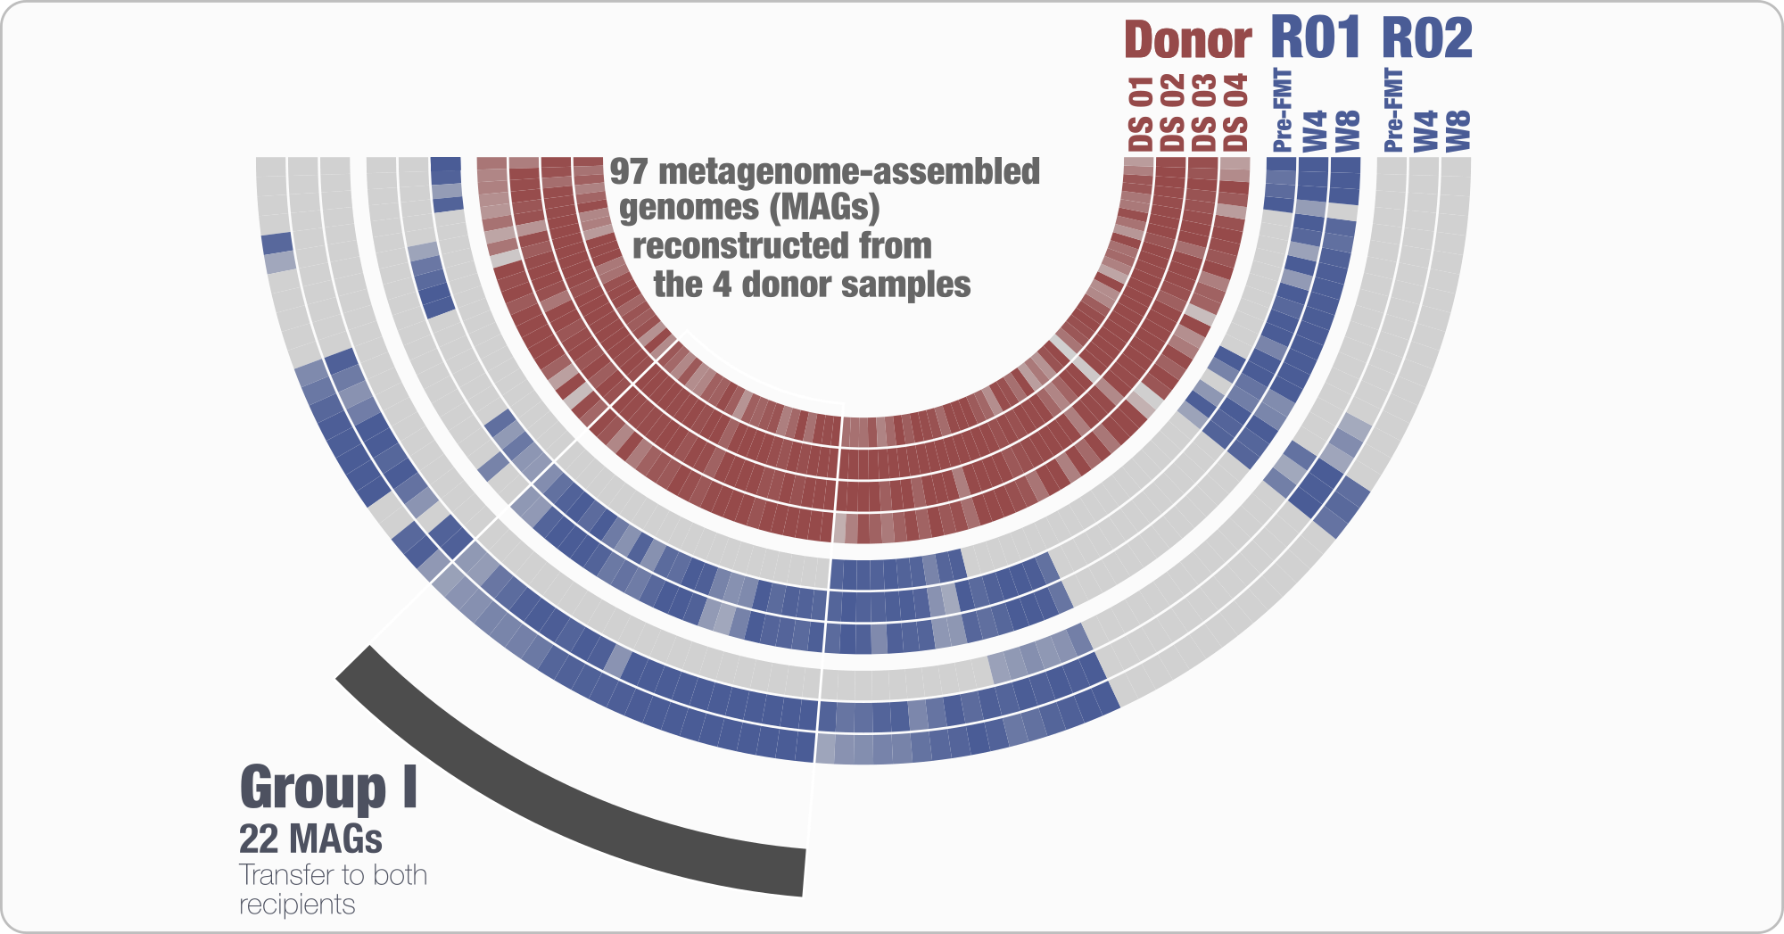
Lee, Sonny TM, et al. Microbiome (2017)

Slide 23
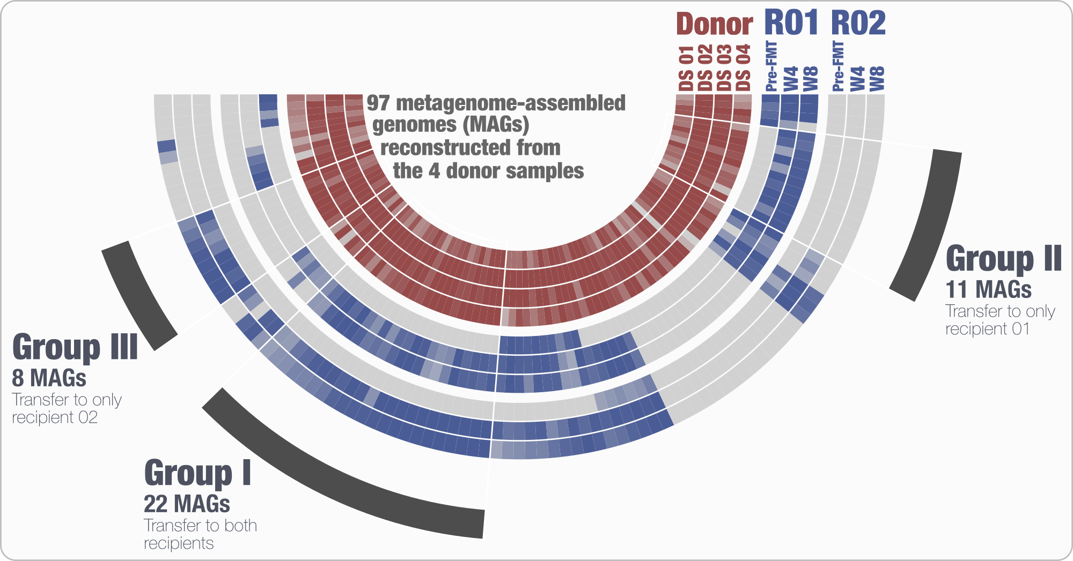
Lee, Sonny TM, et al. Microbiome (2017)

Slide 24
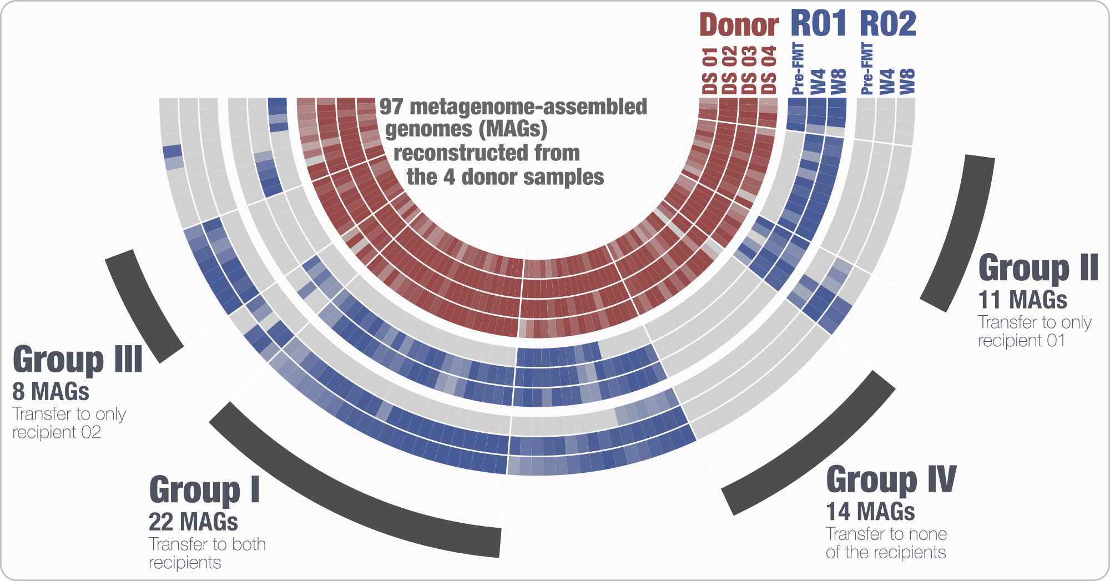
Lee, Sonny TM, et al. Microbiome (2017)

Slide 25
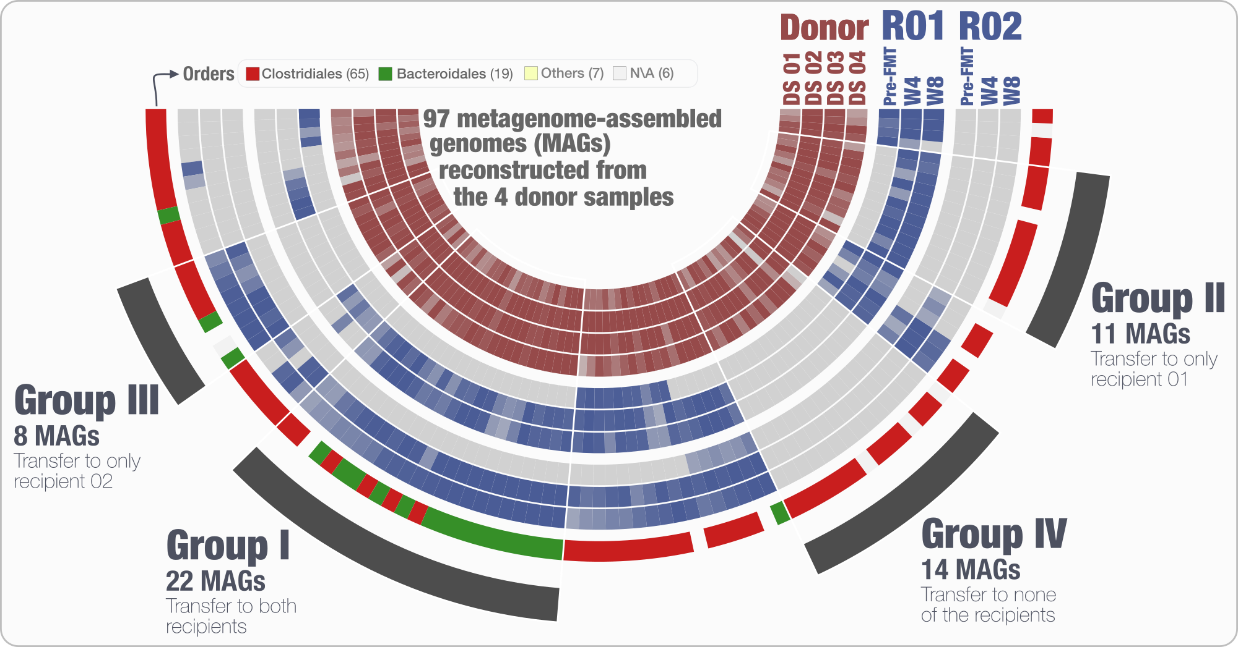
Lee, Sonny TM, et al. Microbiome (2017)

Slide 26
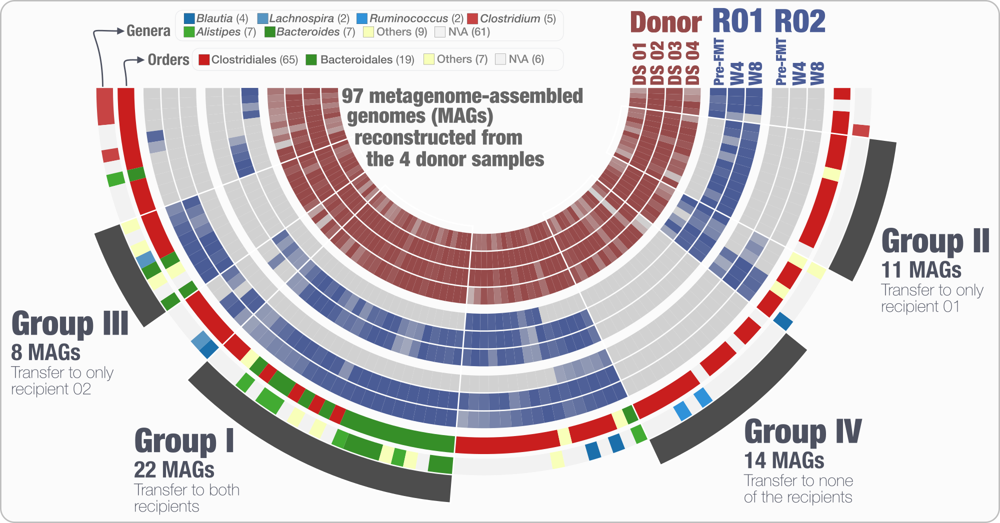
Lee, Sonny TM, et al. Microbiome (2017)

